Slide 1
Environment: Raspberry Pi
DUT
I2C / MDCMDIO
Control Path
Control Panel
Ethernet – Data Path
Switch
Ethernet – Data Path
WiFi – Control Path
Pi 1
Pi 2
Pi 3
Pi 4

Slide 2
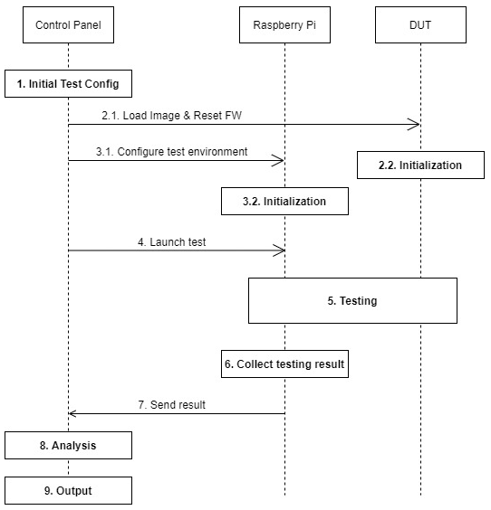
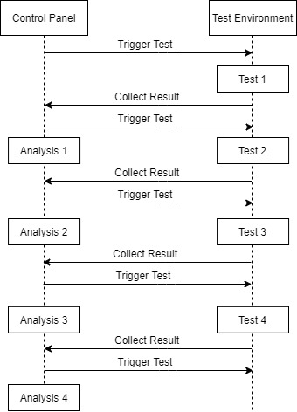
Control Path

Slide 3
Control Panel
Environment configuration abstraction
Analyzing configuration
Configuration Translation Layer
Platform-based
environment configuration
Control Panel Core
DUT communicating
Feature
Analyzing Core
Report Generator
Test Platform communicating
Feature

